Slide 1
Bacchus Winery Case Study Presentation
Jackson Webster

Slide 2

Bacchus Winery Case Study
The goal of this case study was to design a database for Bacchus Winery to manage its key operational data.
The system needed to track:
Wines and their sales
Employees and their working hours
Suppliers, supply items, and orders
Distributors that purchase wine

Slide 3
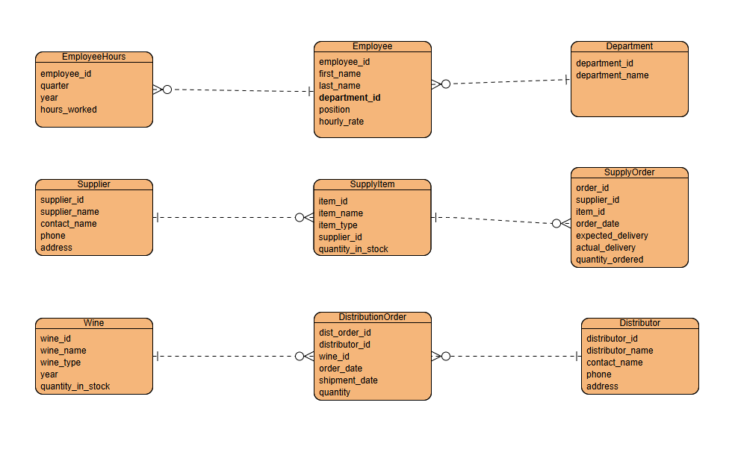
ERD
Key Tables:
Distributor and DistributionOrder – record sales of wine to distributors.
Supplier, SupplyItem, and SupplyOrder – manage suppliers, materials, and inventory orders.
Department, Employee, and EmployeeHours – organize staff and track hours worked.

Slide 4

Reports Created
Top Selling Wines – identifies the wines most frequently ordered by distributors.
Distributor Sales Summary – highlights overall sales performance by distributor to support marketing and distribution decisions.
Supplier Items by Total Quantity Ordered – shows total quantities of supply items ordered from each supplier and helps track supplier orders for inventory and purchasing decisions.
Employee Hours by Department – summarizes employee labor contributions across all departments and supports workforce management and scheduling decisions.

Slide 5

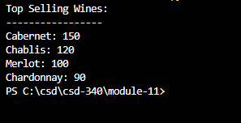
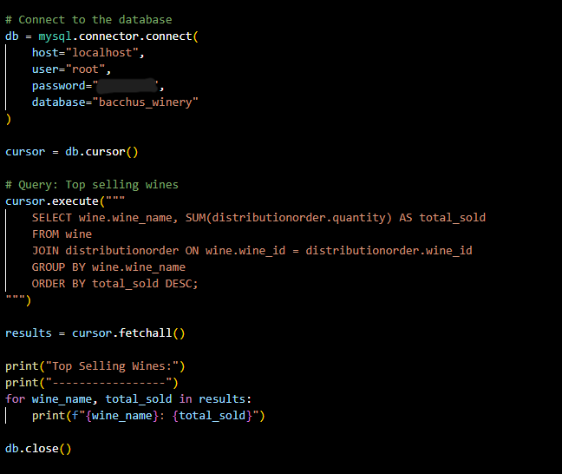
Top Selling Wines
Uses the DistributionOrder table to identify which wines are ordered most frequently by distributors.
Highlights the winery’s best-selling products.
Supports decisions about production and marketing focus.

Slide 6

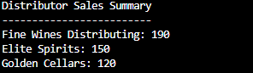
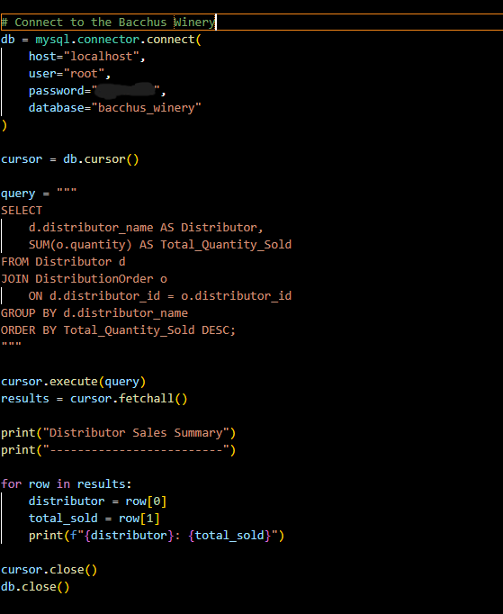
Distributor Sales Summary
Shows total wine quantities sold per distributor
Identifies top distribution partners
Uses Distributor and DistributionOrder tables

Slide 7

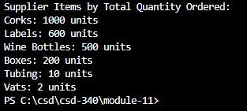
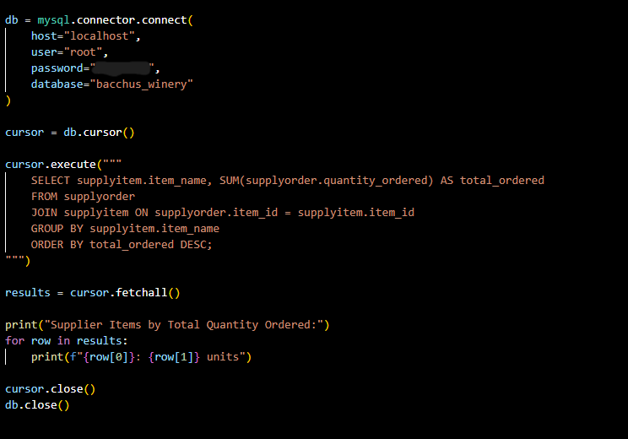

Supplier Items Ordered
Calculates the total number of each SupplyItem ordered from suppliers.
Uses data from the SupplyOrder table.
Helps track supplier orders for inventory and purchasing decisions.

Slide 8

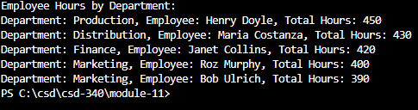
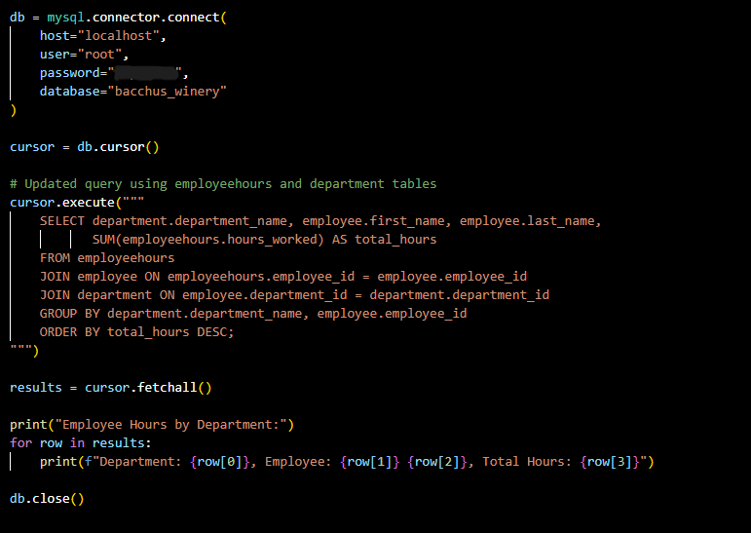
Employee Hours by Department
Summarizes total hours worked by each employee and department.
Uses data from the Employee, Department, and EmployeeHours tables.
Supports workforce management and scheduling decisions.

Slide 9

Design Assumptions and Notes
Each wine is sold through distribution orders linked to a specific distributor.
Each supply item is linked to one supplier, and quantities represent items ordered for production.
Employees belong to only one department.
EmployeeHours records are totaled to generate department summaries.
Pricing data was not included, so reports focus on quantities rather than revenue.

Slide 10

Summary and Results
Through this case study I,
Designed a complete relational database for Bacchus Winery.
Built tables for wines, suppliers, distributors, employees, and orders.
Created and executed Python reports that provide valuable business insights.

